Slide 1

Prediction of customers behavior while purchasing using data mining concepts
- Ganesh kumar
x16130961

Slide 2
Introduction
In retail and grocery stores, It is quite hard to predict the customers that what they are going to purchase.
But it is possible to predict the customers pattern in purchasing using association rules.
For example, customer has to buy milk prior, if he wants to buy coffee or tea powder. So, placing those two products at visible distance, there is more chance of customer to purchase them at once.
This is called Market Basket Analysis.

Slide 3

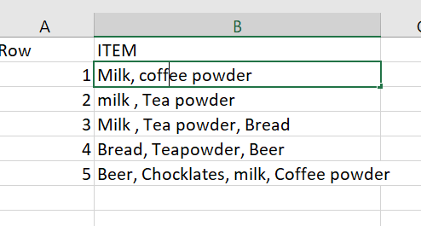
Market Basket Analysis
we have different itemsets in transactions 1,2, 3,4 and 5. An itemset which has k items is called K itemset.
Association rules are created based on this Itemset.
support and confidence are two terms which helps in finding association rules.
Support is the fraction of transactions in which itemset appears. From above table, {milk, Teapowder} itemset appears in three transactions out of five.
support {Milk, Tea Powder}= 3/5
Confidence is how often y appears in itemset that contains x. From above table, Tea powder and milk appears two times out of 4 transactions which has milk.
Confidence {milk, Tea powder} = 2/4

Slide 4
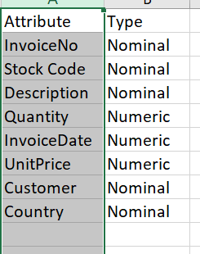
Dataset
Online retail Dataset is taken from UCI repository.
Link : http://archive.ics.uci.edu/ml/datasets/online+retail

Slide 5
Methods & Implementation
Apriori Algorithm:
Apriori algorithm works on transactional databases and large databases and helps in finding relation among them.
It helps in reducing the large data bases.
Implementation:
-Apriori algorithm is applied by using Rstudio
FP Growth Algorithm:
FP growth algorithm was applied in rapid miner to know the How often the item occurs in database.

Slide 6
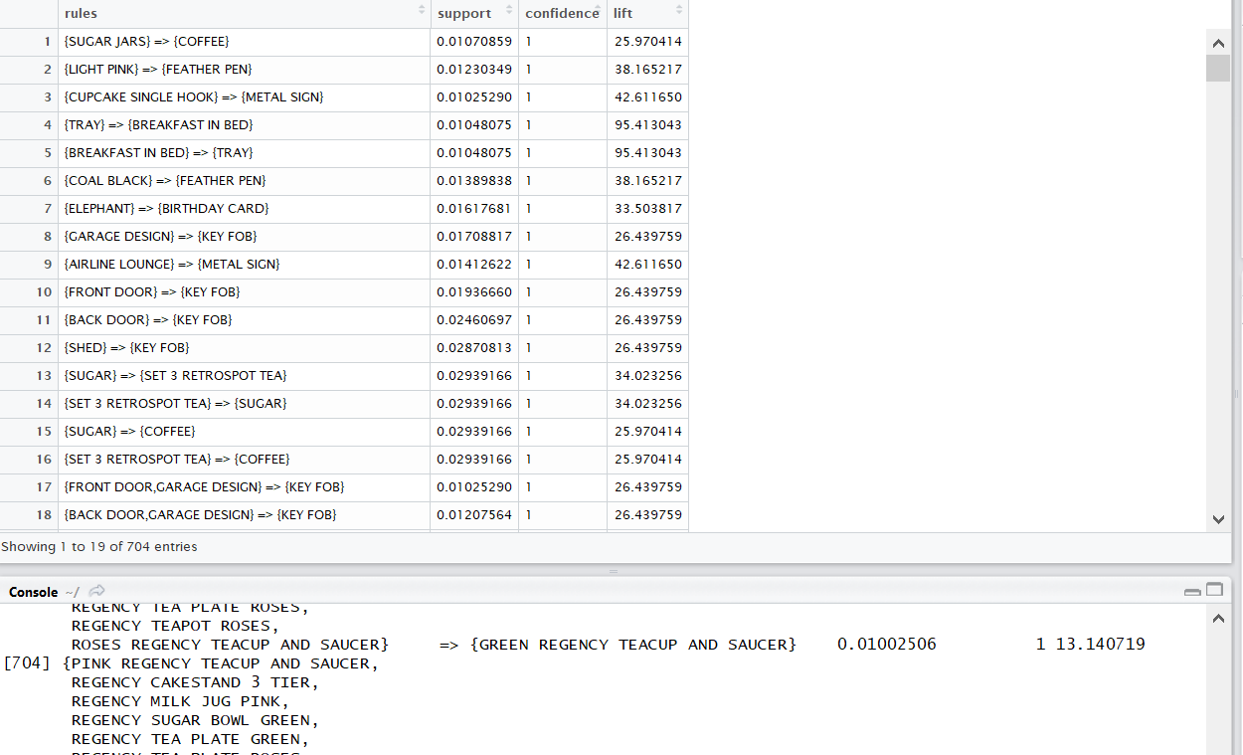
Results Interpretation:
It indicates that , if sugar jars are purchased, then there is likely to be purchase of coffee as well with lift of 25.97
A lift is the measure of the rule.
A lift having greater than 1 has more positive effect of occurrence of rule.
Lift with 25.97 like chances of same things can be purchased at percent of 26.

Slide 7
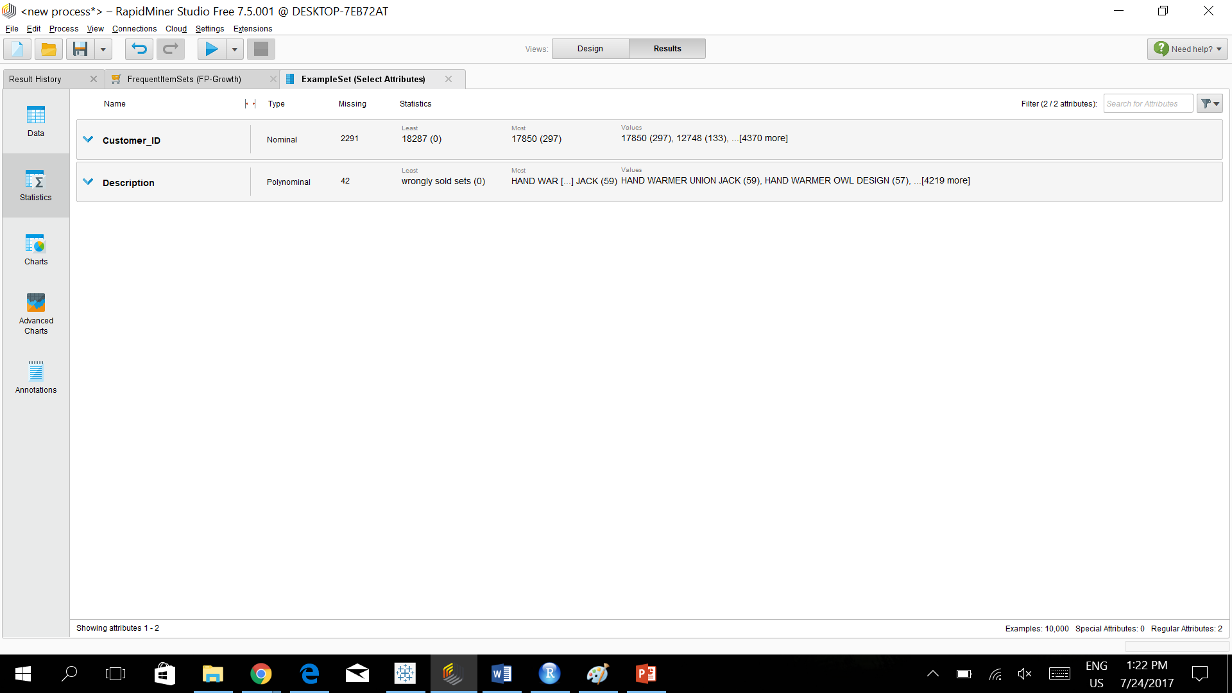
Results:
FP Growth Algorithm:
Represents the quantities of sales.
Helps in finding out which items are mostly sold.

Slide 8
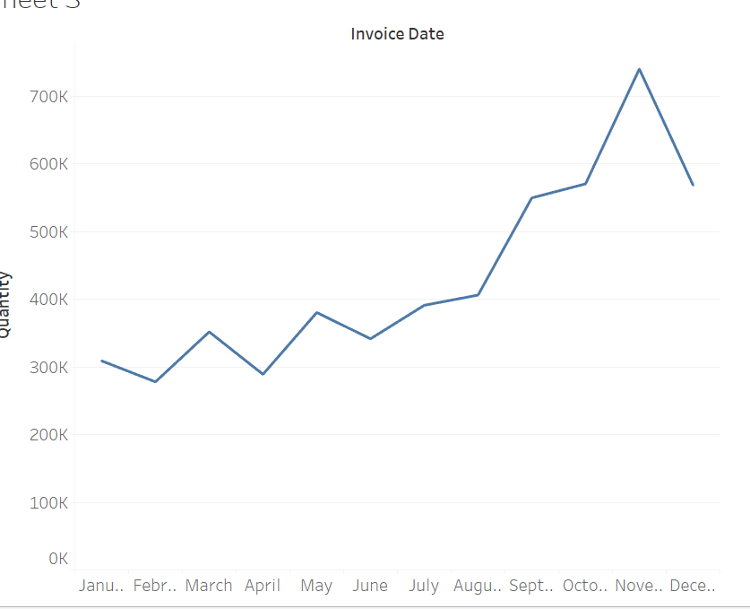
Visualization
Increased Gradually.
Sales tend to be high in November.

Slide 9
Conclusion
Data Mining techniques became more crucial in business areas which helps in decision making for better outcomes. Market basket analysis gives Association rules items that are most likely to be choose by customer and items that are not much sold. With these Association rules, new strategies can be implemented to increase profits in business and a friendly infrastructure can be brought in store.

Slide 10
References:
Utami Sutjipto, S, Sitanggang, I, & Barus, B 2017, 'Potential Usage Estimation of Ground Water using Spatial Association Rule Mining', Telkomnika, 15( 1), pp. 504-511.
Agrawal, R. and Srikant, R., 1994, September. Fast algorithms for mining association rules. In Proc. 20th int. conf. very large data bases. 1215, pp. 487-499.
Agrawal, R., Imieliński, T. and Swami, A., 1993, June. ‘Mining association rules between sets of items in large databases.’ 22, No. 2, pp. 207-216.

Slide 11
Thank you

